Slide 1
Implementation of Graphs
Identification of Classes and Interfaces
  Vertex interface
  Edge interface
  Graph interface
  AbstractGraph class (having the following two inner classes)
    GraphVertex
    GraphEdge
Graph concrete Implementations
  GraphAsMatrix
  GraphAsArrayLists
  GraphAsLists
Review Questions.

Slide 2
Identification of Classes
A graph contains vertices and edges.
We can identify three kinds of objects: vertices, edges, and graphs.
Accordingly, we define three interfaces:
  Vertex
  Edge
  Graph
A graph can be represented in different ways (we have discussed three of them). Accordingly, we use the following six classes
  AbstractGraph (having the following two inner classes)
    GraphVertex
    GraphEdge
  GraphAsMatrix
  GraphAsArrayLists
  GraphAsLists

Slide 3
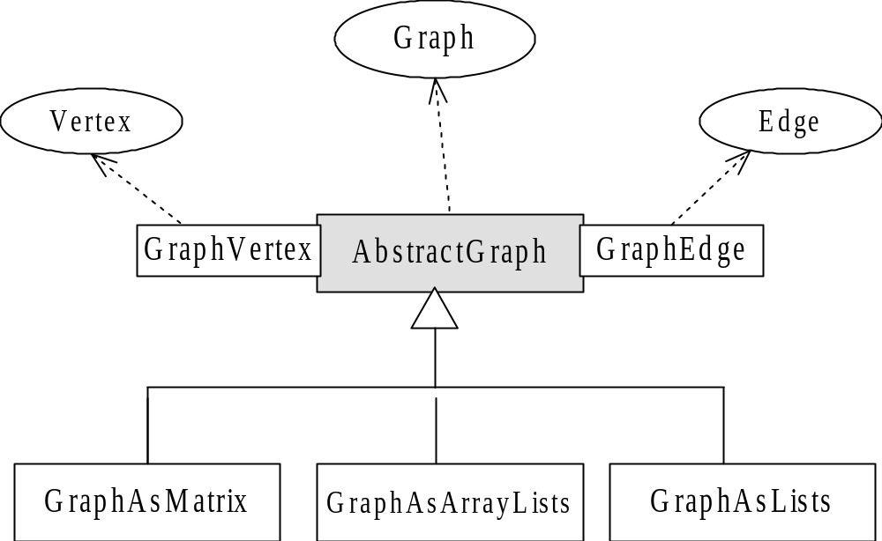
Classes and Interfaces

Slide 4
The Vertex Interface
Each vertex must be distinguishable from other vertices. Thus, each vertex should have a unique label.
Some applications require vertex-weighted graphs.
A vertex type object belongs to exactly one graph. It is neither independent nor shared between two graphs. Otherwise the getIncidentEdges(), and other methods will not make sense.
public interface Vertex extends Comparable
{
public String getLabel();
public Comparable getWeight();
public Iterator getIncidentEdges();
public Iterator getEmanatingEdges();
public Iterator getPredecessors();
public Iterator getSuccessors();
}

Slide 5
The Edge Interface
An edge in a directed graph is an ordered pair of vertices; while in an undirected graph it is a set of two vertices.
We use the same class for both--the context determines whether it is directed or undirected.
Some Graphs are edge-weighted
public interface Edge extends Comparable
{
public abstract Vertex getFromVertex();
public abstract Vertex getToVertex();
public abstract Comparable getWeight();
public abstract boolean isDirected();
public abstract Vertex getMate(Vertex vertex);
}

Slide 6
The Graph Interface
It represents both directed and undirected graphs.
public interface Graph {
public int getNumberOfEdges();
public int getNumberOfVertices();
public Iterator getVertices();
public Iterator getEdges();
public void addVertex(String label);
public void addVertex(String label, Comparable weight);
public Vertex getVertex(String label);
public int getIndex(Vertex v);// vertices are indexed starting from zero
public void addEdge(String from, String to);
public void addEdge(String from, String to, Comparable weight);
public Edge getEdge(String from, String to);
public boolean isReachable(String from, String to);
public boolean isEdge(String from, String to);
public boolean isVertex(String label);
public boolean isDirected();
public boolean isWeighted();
public boolean isConnected();
public abstract boolean isStronglyConnected();
public abstract boolean isWeaklyConnected();
public boolean isCyclic();
public void preorderDepthFirstTraversal(Visitor visitor, Vertex start);
public void postorderDepthFirstTraversal(Visitor visitor, Vertex start);
public void breadthFirstTraversal(Visitor visitor, Vertex start);
public abstract int topologicalOrderTraversal(Visitor visitor);
}

Slide 7
The AbstractGraph class
The following introduces the AbstractGraph class.
public abstract class AbstractGraph implements Graph {
protected int numberOfVertices;
protected int numberOfEdges;
protected boolean directed;
public AbstractGraph(boolean directed){
numberOfVertices = 0;
numberOfEdges = 0;
this.directed = directed;
}
public int getNumberOfVertices(){return numberOfVertices;}
public int getNumberOfEdges(){return numberOfEdges;}
public void purge() {
numberOfVertices = 0;
numberOfEdges = 0;
}
public void addVertex(String label){addVertex(label, null);}
public void addEdge(String from, String to){addEdge(from, to, null);}
public boolean isDirected() {return directed;}
implemented in subclasses

Slide 8
The AbstractGraph class- Cont'd
public boolean isWeighted(){
Iterator p = getEdges();
if(((Edge)p.next()).getWeight() == null) return false;
return true;
}
public Vertex getVertex(String label){
Iterator i = getVertices();
while (i.hasNext()){
Vertex v = (Vertex) i.next();
if (v.getLabel().equals(label)) return v;
}
return null;
}
public Edge getEdge(String from, String to){
Iterator i = getEdges();
while (i.hasNext()){
Edge e = (Edge) i.next();
if (e.getFromVertex().getLabel().equals(from) &&
e.getToVertex().getLabel().equals(to))
return e;
}
return null;
}

Slide 9
The AbstractGraph class- Cont'd
public Iterator getEmanatingEdges(Vertex from) {
Iterator i = getEdges();
MyLinkedList emEdges = new MyLinkedList();
while (i.hasNext()){
Edge edge = (Edge) i.next();
if (edge.getFromVertex().equals(from)) emEdges.append(edge);
}
return emEdges.iterator();
}
public Iterator getIncidentEdges(Vertex to) {
Iterator i = getEdges();
MyLinkedList inEdges = new MyLinkedList();
while (i.hasNext()){
Edge edge = (Edge) i.next();
if (edge.getToVertex().equals(to)) inEdges.append(edge);
}
return inEdges.iterator();
}
public int getIndex(Vertex v){ return getIndex(v.getLabel());}
protected abstract int getIndex(String label);
Other methods of the AbstractGraph class will be discussed in coming lectures

Slide 10
The GraphVertex class
The GraphVertex class is implemented as an inner class:
protected final class GraphVertex implements Vertex {
protected String label; protected Comparable weight;
protected GraphVertex(String s, Comparable w) {
label = s; weight = w;
}
protected GraphVertex(String s) {this(s, null);}
public int compareTo(Object obj) {
return label.compareTo(((GraphVertex)obj).getLabel());
}
public Iterator getIncidentEdges() {
return AbstractGraph.this.getIncidentEdges(this);
}
public Iterator getPredecessors() {
return new Iterator() {
Iterator edges = getIncidentEdges();
public boolean hasNext() {return edges.hasNext();}
public Object next() {
Edge edge = (Edge)edges.next();
return edge.getMate(GraphVertex.this);
}
};
}
}
The getEmanatingEdges and getSuccessors
methods are implemented in the same way.

Slide 11
The GraphEdge class
The GraphEdge class is also implemented as an inner class:
protected final class GraphEdge implements Edge {
protected Vertex startVertex, endVertex;
protected Comparable weight;
protected GraphEdge(Vertex v1, Vertex v2, Comparable w) {
startVertex = v1; endVertex = v2; weight = w;
}
protected GraphEdge(Vertex v1, Vertex v2) {this(v1, v2, null);}
public Vertex getFromVertex() {return startVertex;}
public Vertex getToVertex() {return endVertex;}
public Comparable getWeight() {return weight;}
public Vertex getMate(Vertex v) {
if(v.equals(startVertex)) return endVertex;
if(v.equals(endVertex)) return startVertex;
else throw new InvalidOperationException("invalid vertex");
}
public boolean isDirected() {
return AbstractGraph.this.isDirected();
}
// …
}

Slide 12
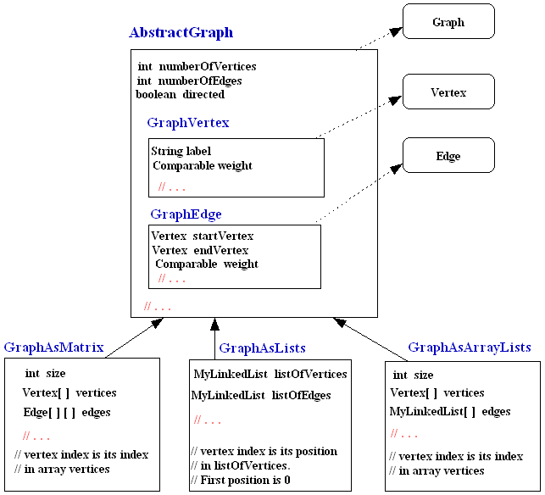
Graph concrete implementations

Slide 13
Implementing GraphAsMatrix (Adjacency Matrix)
The following describes the concrete class, GraphAsMatrix:
public class GraphAsMatrix extends AbstractGraph {
private int size;
private Vertex[] vertices;
private Edge[][] edges;
public GraphAsMatrix(int size, boolean directed) {
super(directed);
this.size = size;
vertices = new GraphVertex[size];
edges = new Edge[size][size];
}
public void purge() {
for (int i=0;i<size;i++){
vertices[i] = null;
for (int j=0;j<size;j++) edges[i][j] = null;
}
super.purge();
}
public int getIndex(String label){
for (int i=0;i<numberOfVertices;i++)
if (vertices[i].getLabel().equals(label)) return i;
return -1;
}

Slide 14
Implementing GraphAsMatrix - Cont'd
public void addVertex(String label, Comparable weight){
if (getIndex(label)!=-1)
throw new IllegalArgumentException("Duplicate vertex");
if (numberOfVertices == size)
throw new IllegalArgumentException("Graph is full");
vertices[numberOfVertices++] = new GraphVertex(label, weight);
}
public void addEdge(String from, String to, Comparable weight){
int i = getIndex(from);
int j = getIndex(to);
if (i==-1 || j==-1)
throw new IllegalArgumentException("Vertex not in this graph");
if (i == j)
throw new IllegalArgumentException("Loops not supported");
if (edges[i][j] == null){
edges[i][j] = new GraphEdge(vertices[i], vertices[j], weight);
numberOfEdges++;
if (!isDirected() && edges[j][i]==null){
edges[j][i]=new GraphEdge(vertices[j], vertices[i],weight);
numberOfEdges++;
}
}
}

Slide 15
Implementing GraphAsMatrix - Cont'd
public Iterator getVertices(){
return new Iterator(){
int index = 0;
public boolean hasNext(){return index < numberOfVertices;}
public Object next(){return vertices[index++];}
};
}
// code is simple if iterators are used. See lab document
public Iterator getEdges() {
return new Iterator(){
int count = 0,i=0,j=0;
public boolean hasNext(){return count < numberOfEdges;}
public Object next(){
if (count==numberOfEdges) throw new NoSuchElementException();
while (i<numberOfVertices && j<numberOfVertices &&
edges[i][j]==null){
j++; if (j==numberOfVertices){j=0;i++;}
}
Edge r = edges[i][j];
count++;
// for next call, adust i and j
j++; if (j==numberOfVertices){j=0;i++;}
return r;
}
};
}

Slide 16
Implementing GraphAsLists (Simple List)
The following describes the concrete class, GraphAsLists:
public class GraphAsLists extends AbstractGraph {
private MyLinkedList listOfVertices, listOfEdges;
public GraphAsLists(boolean directed) {
super(directed);
listOfVertices = new MyLinkedList();
listOfEdges = new MyLinkedList();
}
public void purge() {
listOfVertices.purge();
listOfEdges.purge();
super.purge();
}
public int getIndex(String label){
int index = -1;
MyLinkedList.Element e = listOfVertices.getHead();
while (e != null){
index++;
Vertex v = (Vertex) e.getData();
if (label.equals(v.getLabel())) return index;
e = e.getNext();
}
return -1;
}

Slide 17
Implementing GraphAsLists – Cont’d
public void addVertex(String label, Comparable weight){
if (getIndex(label)!=-1)
throw new IllegalArgumentException("Duplicate vertex");
listOfVertices.append(new GraphVertex(label, weight));
numberOfVertices++;
}
public void addEdge(String from, String to, Comparable weight){
Vertex fromVertex = getVertex(from);
Vertex toVertex = getVertex(to);
if (fromVertex==null || toVertex==null)
throw new IllegalArgumentException("Vertex not in this graph");
if (fromVertex == toVertex)
throw new IllegalArgumentException("Loops not supported");
if (getEdge(from, to)==null){
listOfEdges.append(new GraphEdge(fromVertex, toVertex, weight));
numberOfEdges++;
if (!isDirected() && getEdge(to, from)==null){
listOfEdges.append(new GraphEdge(toVertex, fromVertex, weight));
numberOfEdges++;
}
}
}
public Iterator getEdges() {return listOfEdges.iterator();}
public Iterator getVertices(){return listOfVertices.iterator();}

Slide 18
Implementing GraphAsArrayLists (Adjacency List)
The following describes implementation of graph as Adjacency List
public class GraphAsArrayLists extends AbstractGraph {
private int size;
private Vertex[] vertices;
private MyLinkedList[] edges;
public GraphAsArrayLists(int size, boolean directed) {
super(directed);
this.size = size;
vertices = new GraphVertex[size];
edges = new MyLinkedList[size];
for (int i=0;i<size;i++) edges[i] = new MyLinkedList();
}
// These methods are similar to those in GraphAsMatrix class
public int getIndex(String label)
public void addVertex(String label, Comparable weight)
public Iterator getVertices()
// These methods will be implemented in the lab
public void purge()
public void addEdge(String from, String to, Comparable weight)
public Iterator getEdges()
}

Slide 19
Simple Programming Questions on Graphs
Write an instance method public Edge minWeightEdge() in one of the concrete Graph classes that returns the minimum-weight edge. Your method must throw an appropriate exception if the graph is not weighted. Your method must not use any Iterator.
Write an instance method public int countSpecialEdges() of AbstractGraph that counts the number of edges in the invoking object that have starting vertex greater than ending vertex (based on compareTo method).

Slide 20
Solution for Q1 (In GraphAsMatrix class)
public Edge minWeightEdge(){
boolean isFirstEdge = true;
Edge min = null;
for(int i = 0;i < numberOfVertices; i++){
for(int j = 0;j < numberOfVertices; j++){
if(edges[i][j]!=null){
if(edges[i][j].getWeight()==null)
throw new IllegalArgumentException(
"The graph is not weighted");
if(isFirstEdge){
min = edges[i][j];
isFirstEdge = false;
} else if(edges[i][j].getWeight().compareTo(
min.getWeight())<0)
min = edges[i][j];
}
}
}
return min;
}

